Slide 2
Notes:
Always get the latest copy of this deck from: http://my.oracle.com/content/idcplg?IdcService=GET_FILE&dID=6133816&dDocName=CNT2438449&allowInterrupt=1
v2 … Published August 13th 2015
Questions? Comments? kelly.goetsch@oracle.com

Slide 3


Microservices + Oracle | A Bright Future
Kelly Goetsch
Director, Product Management
August 31st 2015

Slide 4
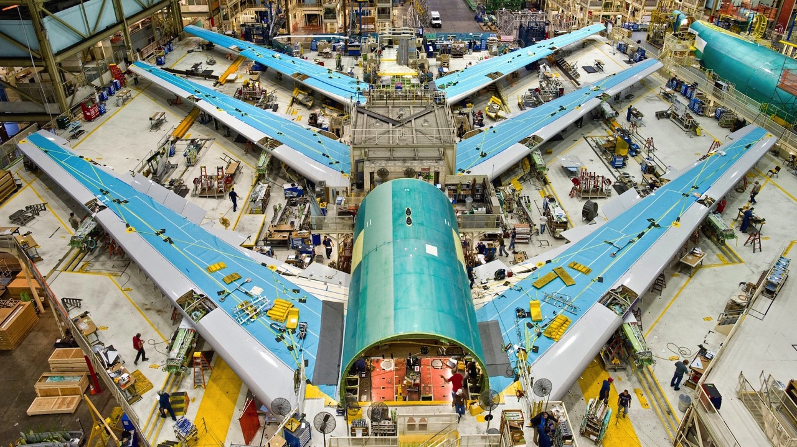
Introduction
Notes:
Like the Boeing 787, microservices are designed, built, and tested off-site in many different pieces before being assembled into a single cohesive application

Slide 5
Characteristics of Existing Deployment Architecture
The status quo has served us well but there are new alternatives
Large Monolithic Application
One large archive, including UI(s) and application code
Three tiers
Many “named” servers that perform only one function and cannot go down
Scale by cloning behind load balancer (X-axis scaling)
One programming language
Everything centralized – messaging, storage, database, etc
Application Container
Feature-rich – support large, complicated applications, many use cases
Operating System
VM
Hypervisor
Provide 100% isolation between tenants
Operating System
Hardware
Procured and manually set up

Slide 6
Existing Deployment Architecture Has its Limits
Too Complex
No Specialization
Apps get too big and complicated for a developer to understand over time. Shared layers (ORM, messaging, etc) have to handle 100% of use cases – no point solutions
Different parts of applications have different needs – more CPU, more memory, faster network, etc
Too Complex
No
Specialization
Too Slow
No Ownership
Teams split up by function – UI, application, middleware, database, etc. Takes forever to get anything done due to cross-ticketing
Too
Slow
No
Ownership
Code falls victim to “tragedy of the commons” – when there’s little ownership, you see neglect
Too Fragile
Inefficient
Testing
Too Fragile
Inefficient Testing
A bug will quickly bring down an entire application. Little resiliency
Each time you touch the application, you have to re-test the whole thing. Hard to support continuous delivery

Slide 7
What Are Microservices?
Minimal function services that are deployed separately but can interact together to achieve a broader use-case
Status Quo
Microservices
Single, Monolithic App
Must Deploy Entire App
One Database for Entire App
In-process Calls Locally, SOAP Externally
Organized Around Technology Layers
Developers Don’t Do Ops
State In Each Runtime Instance
One Technology Stack for Entire App
Many, Smaller Minimal Function Microservices
Can Deploy Each Microservice Independently
Each Microservice Has Its Own Datastore
REST Calls Over HTTP, Messaging, or Binary
Organized Around Business Capabilities
Developers + Ops Support Production in Perpetuity
State in Distributed Data Grid – Instances Stateless
Choice of Technology for Each Microservice

Slide 8
Microservices Apps Are Developed/Deployed Independently
Status Quo
Microservices
API
API
User Interface
Application
Application
Datastore
Datastore
Infrastructure
Infrastructure
Application
Inventory
Microservice
Payment
Microservice
Datastore
API
API
Application
Application
Infrastructure
Datastore
Datastore
Infrastructure
Infrastructure
Profile
Microservice
Product Catalog
Microservice
One Application
Many Small Microservices

Slide 9

Top 5 Signs It’s Time To Look at Microservices
100+ developers for an app
5m lines of code for an app
Monthly or quarterly releases to production
> 1 quarter backlog of development work
> 20% developer turnover

Slide 10

Common Microservice Adoption Use Cases
I want to extend my existing monolithic application by adding microservices on the periphery.
I want to decompose an existing modular application into a microservices-style application
I want to build a net new microservices-style application from the ground up.

Slide 11
How Big Should a Microservice Be?
Can have hundreds of microservices for a larger application
Large
11-15 People
Example: Order Microservice
Do One Thing and Do It Well
Medium
4-10 People
Example: Inventory Microservice
Avoid Inter- dependencies
Small
1-3 People
Example: Order Status Microservice
Focus on Business Capabilities

Slide 12
“Micro” in Microservices != Runtime Weight
Microservices tend to use smaller runtimes but you can use what you have today
Monoliths
Microservices
Module 1
Module 2
Module N
Module 1
Middleware
Middleware
Must support the requirements of ALL modules
Must support the requirements of one module
Datastore
Datastore
Fully Featured Runtimes That Support All Use Cases
Light Runtimes That Do One Thing
Notes:
Can use fully featured products, like WebLogic and Oracle DB.

Slide 13
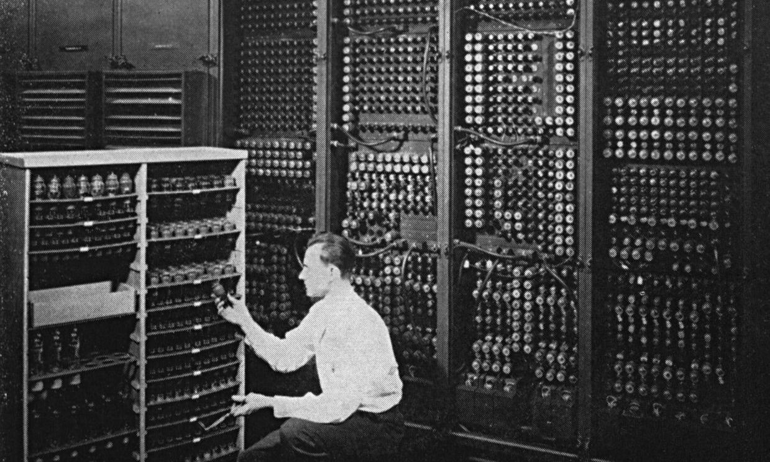
History of Microservices
Microservices go way back

Slide 14
Microservice Principles Have Been With Us For Decades
Loose Coupling
Do One Thing and Do It Well
Reduce Complexity Through Modularization
Focus on Business Capabilities, Not Technology Layers
The principles behind microservices are often just good architecture principles

Slide 15
SOA vs. Microservices
SOA is the general idea, where microservices are a very specific way of achieving it
All of the tenets of SOA also apply to microservices
Keeping consumption of services separate from the provisioning of services
Separating infra management from the delivery of application capability
Separating teams and decoupling services
SOA
Implementation Differences
Favors centralized orchestration
Needlessly complicated by SOAP
“Dumb endpoints, smart pipes”
Microservices
Favors distributed choreography
REST + HTTP/S = simple
“Smart endpoints, dumb pipes”

Slide 16

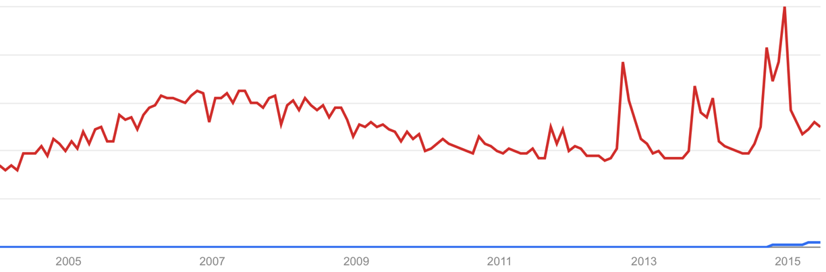
SOA Still Reigns Supreme
It's not going away
“SOA”
“Microservices”

Slide 17
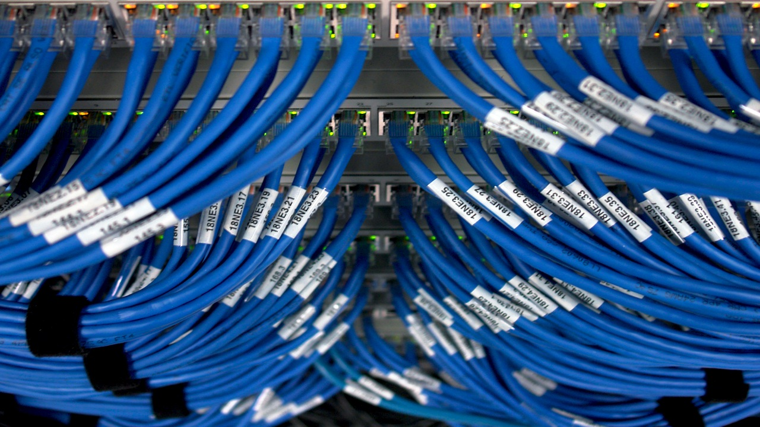
Technical Prerequisites

Slide 18
Technical Ingredients for Microservices Implementation
Service Registry
API Load Balancer
API Gateway
100% Required for Microservices
Service Discovery
Security
Configuration
Eventing
Messaging
Logging
Security
Monitoring
Scaling
Microservices

Slide 19
Key Microservices Technology – Service Registry
Microservice Infrastructure
Runtime Instances
Manages the lifecycle of each microservice endpoint
Newly-instantiated endpoints register with Service Registry
Service Registry continually polls each endpoint’s health
Aware of tenants, microservice versions, and environments
Health checking and selecting the most appropriate endpoint are very much dependent upon the tenant, version, and environment
Can query for an endpoint based on those attributes
Service Registry
Still Alive?
Java Cloud Service
(instances 1...N)
What’s the best endpoint to use for microservice X?
Just added a new endpoint
Java SE Cloud Service
(instances 1...N)
Node Cloud Service
(instances 1...N)
API Load Balancer
Use This Endpoint
Compute Cloud Service
(instances 1...N)
Client HTTP request
Runtime X
(instances 1...N)

Slide 20
Key Microservices Technology – API Load Balancer
Microservice Infrastructure
Runtime Instances
Matches each request to the best endpoint
Queries Service Registry to determine the best endpoint
Ideally stateless – looks up the best endpoint for each HTTP request
Uses load balancer or web server as the core. Typical implementations are customized Oracle Traffic Director, Nginx, or Apache mod_rewrite
Handles logging, request rate limiting, authentication
Service Registry
Still Alive?
Java Cloud Service
(instances 1...N)
What’s the best endpoint to use for microservice X?
Just added a new endpoint
Java SE Cloud Service
(instances 1...N)
Node Cloud Service
(instances 1...N)
API Load Balancer
Use This Endpoint
Compute Cloud Service
(instances 1...N)
Client HTTP request
Runtime X
(instances 1...N)

Slide 21
API Gateways Load Balance and Aggregate Responses
API gateways provide a "backend for each frontend"
Client
Builds a XML or JSON response for each type of client – web, mobile, etc
Asynchronously calls each of the N microservices required to build a response
Handles security and hides back-end
Load balances
Applies limited business logic
Meters APIs
Logs centrally
Common solutions: Netty, Vertex, Nginx, Kong, Apigee
Public Internet
Data Center
API Gateway
Microservice
Microservice
Microservice
Microservice
Microservice
Microservice
Microservice
Microservice
Microservice

Slide 22
Putting It All Together: Typical Solution Architecture
Telemetry
Service Discovery + Load Balancer
Microservice A
I exist at URI X
Log Analysis
Client - Web
Instance 1
Monitoring/Alerting
Give me a URI for Microservice A
I’m still alive
HTTP
HTTP/REST
Instance 2
Client - Mobile
API Gateway
Instance 3
Supporting Services
Client - X
HTTP/REST
Configuration
Microservice B
IdM + IaM
Can I talk to microservice A?
Messaging – Brokered Persistent
Instance 1
Does This Person Exist?
Directory Service
Instance 2
Messaging – Non-brokered Eventing
Instance 3
NoSQL
Client
Cloud
Provisioned using DevOps tooling
RDBMS

